Slide 1
NASH Registrational Trial Options

Slide 2
Phase 2b Study Design
Week 0
SEL 18 mg
72
+
+
+
ACC 20 mg QD
n=120
SEMA
CILO/FIR
Cirrhosis (F4)
(N=440)
3:3:3:2 active vs placebo
Stratify by diabetes, ELF ≥11.3
Endpoints
Histology
NITs (e.g., ELF, FibroScan)
n=120
SEMA
n=120
CILO/FIR
n=80
Placebo
SEMA Dose Escalation
0.24 – 1.7 mg escalation
2.4 mg QW (once weekly)
Biopsy
NITs
Notes:
In particular highlight 9:2 active to placebo ratio 6:5 for patients getting semaglutide as a selling point for recruitment and

Slide 3
Phase 2b Study Design – Testing Strategy
Single primary endpoint
PE: Fibrosis improvement triple vs placebo
SE1: Fibrosis improvement triple vs SEMA
SE2: NASH resolution triple vs placebo
SE3: NASH resolution triple vs CILO/FIR
Meet PE: 2-sided P < 0.05
Meet SE1:
2-sided P < 0.05
Meet SE2:
2-sided P < 0.05
Meet SE3:
2-sided P < 0.05

Slide 4

Seamless Design - Schema
IA Futility
IA Efficacy
SEMA/CILO/FIR
n = 120
n = 195
SEMA
n = 120
CILO/FIR
n = 120
n = 195
Placebo
n = 80
n = 130

Slide 5
Seamless Design – Testing Strategy
Option 1: single primary endpoint
Option 2: dual primary endpoint
PE: Fibrosis improvement triple vs placebo
SE1: Fibrosis improvement CILO/FIR vs placebo
SE1: Fibrosis improvement triple vs SEMA ?
SE2: NASH resolution triple vs placebo
SE3: NASH resolution triple vs CILO/FIR ?
PE1: Fibrosis improvement triple vs placebo
PE2: Fibrosis improvement CILO/FIR vs placebo
SE1: Fibrosis improvement triple vs SEMA ?
SE1: NASH resolution triple vs placebo
SE3: NASH resolution triple vs CILO/FIR ?
Meet PE: Efficacy at IA or FA
Meet both PE1 and PE2: Efficacy at Interim or Final
0.01
0.005
0.005
Meet SE1:
Efficacy at IA or FA
Meet PE1: Efficacy at Interim or Final
Meet PE2: Efficacy at Interim or Final
Meet SE2:
Efficacy at IA or FA
Meet SE1:
Efficacy at Interim or Final
Maintain the overall type I error of 0.01 (2-sided)

Slide 6
Seamless Design – Testing Strategy Option 1
IA
FA
PE | SE1
Positive P ≤ 0.0001 | Positive P ≤ 0.0001
 | Promising 0.0001 < P < 0.3
 | Negative P ≥ 0.3
Promising 0.0001 < P < 0.3 | Promising P < 0.3
 | Negative P ≥ 0.3
Negative P ≥ 0.3 | Negative Any P
Efficacy and futility criteria for PE and SE1
 | IA | FA
Efficacy | P ≤ 0.0001 | P ≤ 0.009948*
Futility | P ≥ 0.3
?
CILO/FIR
SE1 Efficacy
Placebo
* Efficacy criteria at FA will be adjusted according to the actual % information at interim for each endpoint
Triple
PE Efficacy
SE1 Efficacy
CILO/FIR
Placebo
Triple
PE Efficacy
Placebo

Slide 7
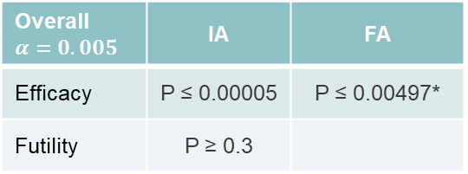
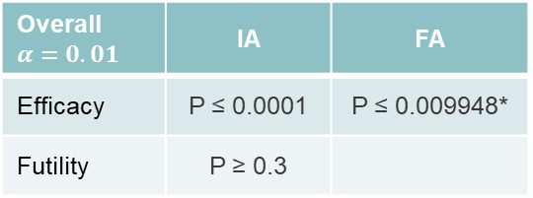
Seamless Design – Testing Strategy Option 2
IA
FA
Efficacy and futility criteria for PE1 and PE2
PE1 | PE2
Positive P ≤ 0.00005 | Positive P ≤ 0.0001
 | Promising 0.0001 < P < 0.3
 | Negative P ≥ 0.3
Positive P ≤ 0.0001 | Positive P ≤ 0.00005
Promising 0.0001 < P < 0.3
Negative P ≥ 0.3
Promising 0.00005 < P < 0.3 | Promising 0.00005 < P < 0.3
Promising 0.00005 < P < 0.3 | Negative P ≥ 0.3
Negative P ≥ 0.3 | Promising 0.00005 < P < 0.3
Negative P ≥ 0.3 | Negative P ≥ 0.3
Overall $α=0.005$ | IA | FA
Efficacy | P ≤ 0.00005 | P ≤ 0.00497*
Futility | P ≥ 0.3
2a
1a
1b
Triple
0.009948
0.00497
Placebo
PE1 Efficacy
PE1 Efficacy
Overall $α=0.01$ | IA | FA
Efficacy | P ≤ 0.0001 | P ≤ 0.009948*
Futility | P ≥ 0.3
2a
2b
1a
CILO/FIR
0.009948
0.00497
Placebo
PE2 Efficacy
PE2 Efficacy
3
3
* Efficacy criteria at FA will be adjusted according to the actual % information at IA for each endpoint
Triple
0.00497
0.00497
1b
CILO/FIR
PE1 Efficacy
PE2 Efficacy
Placebo
2b

Slide 8
Seamless Design – Testing Strategy Option 2a
IA
FA
Efficacy and futility criteria for PE1 and PE2
PE1 | PE2
Positive P ≤ 0.00005 | Positive P ≤ 0.0001
 | Promising 0.0001 < P < 0.3
 | Negative P ≥ 0.3
Positive P ≤ 0.0001 | Positive P ≤ 0.00005
Promising 0.0001 < P < 0.3
Negative P ≥ 0.3
Promising 0.00005 < P < 0.3 | Promising 0.00005 < P < 0.3
Promising 0.00005 < P < 0.3 | Negative P ≥ 0.3
Negative P ≥ 0.3 | Promising 0.00005 < P < 0.3
Negative P ≥ 0.3 | Negative P ≥ 0.3
Overall $α=0.005$ | IA | FA
Efficacy | P ≤ 0.00005 | P ≤ 0.00497*
Futility | P ≥ 0.3
2a
1a
1b
Triple
0.009948
0.00497
Placebo
PE1 Efficacy
PE1 Efficacy
Overall $α=0.01$ | IA | FA
Efficacy | P ≤ 0.0001 | P ≤ 0.009948*
Futility | P ≥ 0.3
2a
2b
1a
CILO/FIR
0.009948
0.00497
Placebo
PE2 Efficacy
PE2 Efficacy
3
3
* Efficacy criteria at FA will be adjusted according to the actual % information at IA for each endpoint
Selected
0.00497
1b
Placebo
Selected PE Efficacy
2b

Slide 9

Seamless Design – Testing Strategy Option 2a
When both PEs are promising at IA, criteria for selecting one treatment to the Ph3 portion
IA
$$∆_{2}−∆_{1}$$
PE1 | PE2
Promising 0.00005 < P < 0.3 | Promising 0.00005 < P < 0.3
CILO/FIR
5%
SEMA contribution on NASH resolution ≥ 5% → Triple
SEMA contribution on NASH resolution < 5% → CILO/FIR
FA
0
SEMA contribution on NASH resolution ≥ 5% → Triple
SEMA contribution on NASH resolution < 5% → CILO/FIR
Selected
0.00497
– 5%
Placebo
Selected PE Efficacy
Triple
* $∆_{1}$ and $∆_{2}$ are the observed treatment effect (after missing data imputation) at IA for PE1 (triple vs pbo) and PE2 (CILO/FIR vs pbo)

Slide 10
Back Up

Slide 11
Futility IA Assessment on PE – Testing Strategy Option 1
Futility Criteria | True Tx Effect | Dropout 15% | Dropout 15% |  | Dropout 20% | Dropout 20%
Futility Criteria | True Tx Effect | Study Power (w/o Futility) | Prob of Stopping due to Futility | Power Loss | Study Power (w/o Futility) | Prob of Stopping due to Futility | Power Loss
P ≥ 0.2 | 0% | 0.4% | 90.1% | 0.1% | 0.4% | 90.2% | 0.1%
10% | 15% | 90.0% | 13.0% | 8.2% | 87.2% | 14.9% | 8.7%
 | 20% | 99.2% | 3.4% | 3.1% | 98.7% | 4.4% | 3.8%
P ≥ 0.3 | 0% | 0.4% | 84.9% | 0.1% | 0.4% | 84.8% | 0.1%
15% | 15% | 90.0% | 8.0% | 4.5% | 87.2% | 9.5% | 4.9%
 | 20% | 99.2% | 1.8% | 1.5% | 98.7% | 2.3% | 1.9%
P ≥ 0.4 | 0% | 0.4% | 80.0% | 0.0% | 0.4% | 79.9% | 0.0%
20% | 15% | 90.0% | 5.4% | 2.8% | 87.2% | 6.5% | 3.0%
 | 20% | 99.2% | 1.1% | 0.9% | 98.7% | 1.4% | 1.1%
N = 80:120 at IA; N = 210:315 at FA ; Placebo Rate = 12%; Study power computed based on GSD with alpha of 0.0001 spending at IA to maintain an overall 2-sided alpha of 0.01 when futility IA is not incorporated; Missing data imputed with non-responder imputation method (NRI)

Slide 12
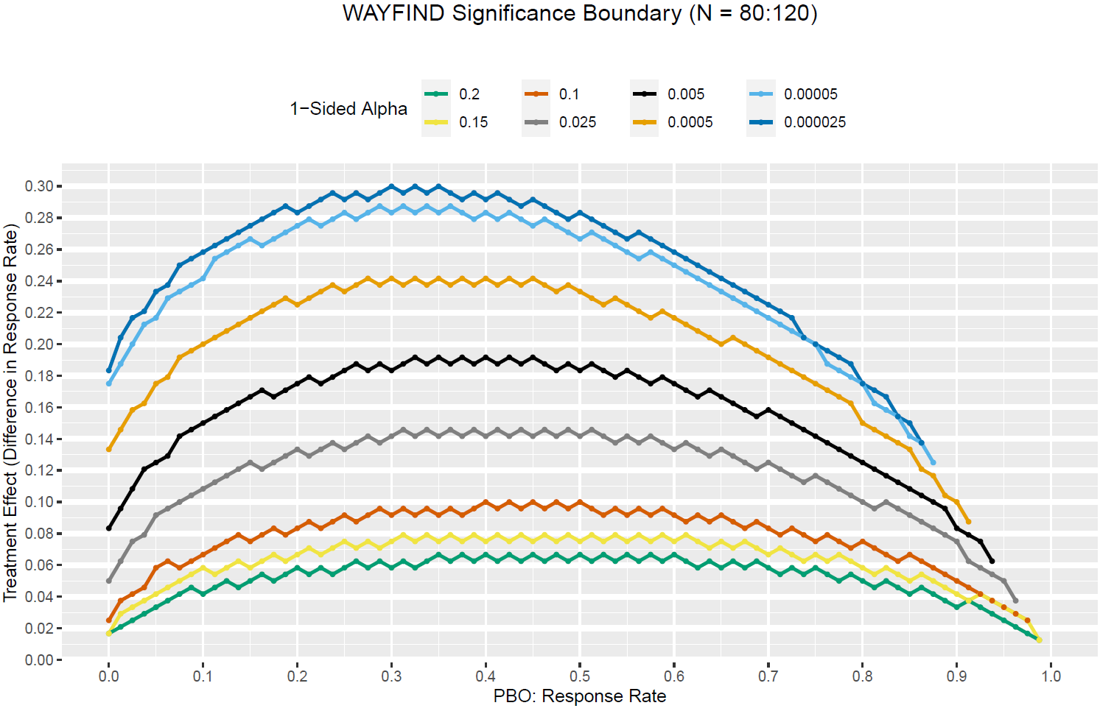

Slide 13
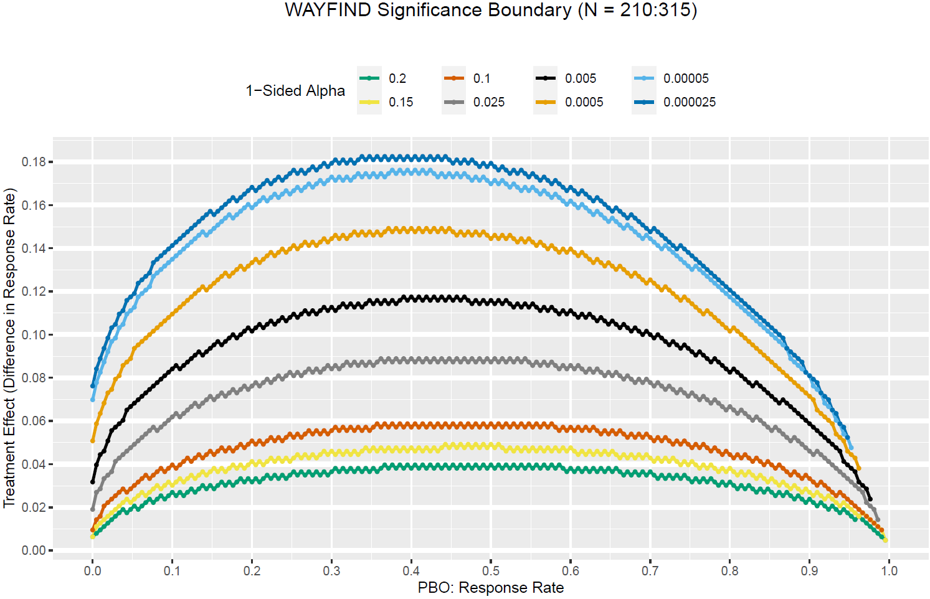

Slide 14
Options
WAYFIND
Ph3
Base:
FI (N = 440)
FI (N = 488)
Event
As is
2-sided p < 0.01; dropout 10%; 90% power
Option 1:
FI (N = 440)
FI (N = 342)
Event
Convert to registrational
2-sided p < 0.05; 20% dropout; ~62% power
2-sided p < 0.05 ; dropout 10%; 90% power
Option 2:
FI (N = 440)
N = 713
Event
4-arm expansion before readout
2-sided p < 0.01; dropout 15%; 90% power
Option 3:
FI (N = 440)
N = 324
Event
Seamless Ph2b/3 design: 4-arm to 2-arm
2-sided p < 0.01; dropout 15%; 90% power
All N and powers were computed based on 3:2 randomization; Placebo Rate = 12%; True treatment effect = 15%
Missing data imputed with non-responder imputation method (NRI) (not as specified in the current protocol)

Slide 15
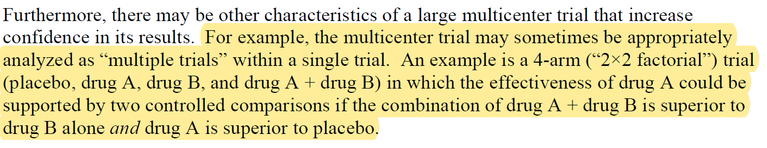
FDA Guidance – Demonstrating Substantial Evidence of Effectiveness
Option 4:
FI (N = 440)
Event
?
Convert to registrational for CILO/FIR
20% dropout
Co-primary with 2-sided p < 0.05:
Triple vs SEMA (~74% power)
CILO/FIR vs Placebo (~62% power)
https://www.fda.gov/regulatory-information/search-fda-guidance-documents/demonstrating-substantial-evidence-effectiveness-human-drug-and-biological-products

